Slide 1
Neural material transfer
for improving photogrammetry
L. Peretti¹, A. Maggiordomo², M. Callieri³, M. Corsini³, D. Giorgi³, P. Cignoni³, M. Tarini²
¹Universita di Pisa, Pisa, Italy
²Universita di Milano, Milano, Italy
³ISTI - CNR, Pisa, Italy

Slide 2
Introduction
3D models can be created using acquisition techniques:
Active (e.g. Laser scanner)
Passive (e.g. Photogrammetry)
Photogrammetry: Technique that allows the reconstruction of 3D models
from multiple captured photographs of an object.
The process involves two major phases:
the images capture phase
reconstruction pipeline that uses the acquired images as input.
Images capture
Feature extraction
Image Matching
Structure from motion
Depth maps estimation
Meshing
Texturing
Photogrammetric pipeline
1

Slide 3
Problem
The reconstruction quality of a model depends on the material of the acquired object.
Goal
Use material transfer to the input images, to obtain dull materials from acquired reflective materials, improving 3D photogrammetric reconstructions.
Image preprocess
Images capture
Feature extraction
Image Matching
Structure from motion
Depth maps estimation
Meshing
Texturing
2

Slide 4
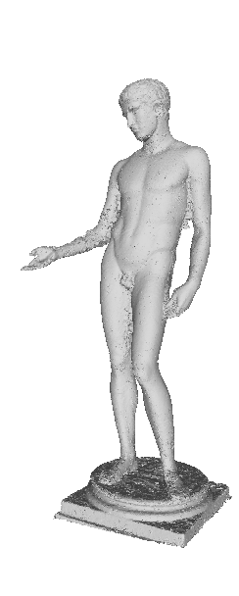
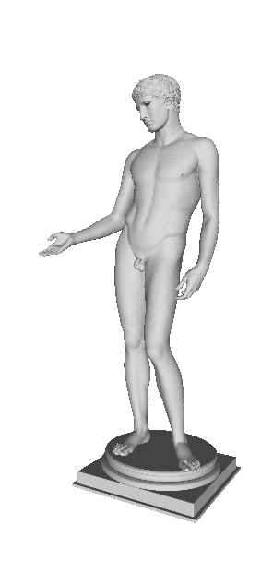
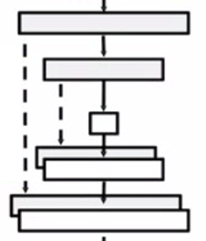

Overview and Contributions
Generate an image dataset of rendered models.
Apply material transfer to the input images, to obtain dull materials from acquired reflective materials.
Reflective materials
renderings
Feature extraction
Image Matching
Structure from motion
Depth maps estimation
Meshing
Texturing
Photogrammetry pipeline
2) Material
transfer
Evaluation
3D models
1) Dataset
generation
dull materials
renderings
Feature extraction
Image Matching
Structure from motion
Depth maps estimation
Meshing
Texturing
3
Photogrammetry pipeline

Slide 5
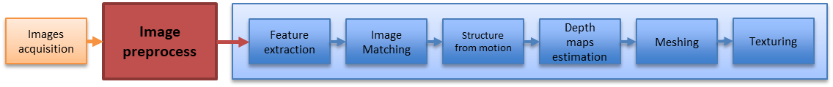
Contributions
Generate synthetic image dataset of rendered images.
Apply material transfer to the input images, to obtain dull materials from acquired reflective materials.
4

Slide 6
Synthetic Dataset generation
5

Slide 7
Synthetic Dataset generation
Set of images
simulating photogrammetry
acquisitions
DATASET
5

Slide 8
Synthetic Dataset generation
DATASET
MODEL1
MODEL2
MODEL3
MODEL52
https://threedscans.com
5

Slide 9
Synthetic Dataset generation
DATASET
MODEL1
MODEL2
MODEL3
MODEL52
Reflective
MATERIAL 1
MATERIAL 8
Dull
5

Slide 10
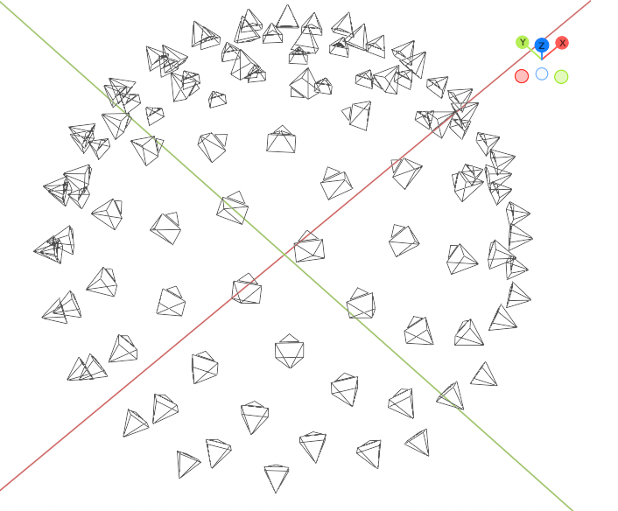
Synthetic Dataset generation
DATASET
MODEL1
MODEL2
MODEL3
MODEL52
MATERIAL 1
MATERIAL 8
Rendering 1
Rendering 100
5

Slide 11
Synthetic Dataset generation
DATASET
MODEL1
MODEL2
MODEL3
MODEL52
MATERIAL 1
MATERIAL 8
Rendering 1
Rendering 100
100 images (3120x2080)
x8 materials (4M+4O)
x52 models
20.800 image pairs {M_{i}, O_{i}} {Reflective, Dull}
Camera locations and orientations
5

Slide 12
Synthetic Dataset generation
Results
6

Slide 13

Synthetic Dataset generation
Results
We released the synthetic dataset generation software package
on GitHub under MIT license.
Python3.8
Blender Python API
The Python code is organized in the following modules:
loader provides access to 3D module files.
material provides BRDFs parameters of the materials
renderer is responsible for the single rendering of each image.
scene constructs the Blender scene, combining lighting, cameras, …
https://github.com/HoenikkerPerez/DIP
7

Slide 14
Contributions
Generate synthetic image dataset of rendered images.
Apply material transfer to the input images, to obtain dull materials from acquired reflective materials.
Image preprocess
Images acquisition
Feature extraction
Image Matching
Structure from motion
Depth maps estimation
Meshing
Texturing
8

Slide 15
Data-driven preprocess
Dataset
  20.800 image pairs {reflective, dull}
  Image size: 512x512 (cropped and resized)
  Dataset split:
  Test set: Images of 4 models (out of 52)
  Training set: 80% of remaining 48 models
  Validation set: 20% of remaining 48 models
9

Slide 16

Data-driven preprocess
Pix2Pix
PatchGan
PixelGan
GENERATOR
DISCRIMINATOR
10
*Isola P et al. Image-to-image translation with conditional adversarial networks. In Proceedings of the CVPR, pages 1125–1134, 2017.

Slide 17
Data-driven preprocess
Pix2Pix
Patch
Discriminator
MSE_{val_set} = 0.0010 ± 0.0006, SSIM_{val_ set} = 0.93 ± 0.04
specular components are removed
tiling artefacts are visible in the background.
Pixel
Discriminator
MSE_{val_ set} = 0.0004 ± 0.0002, SSIM_{val_ set} = 0.96 ± 0.01
11

Slide 18
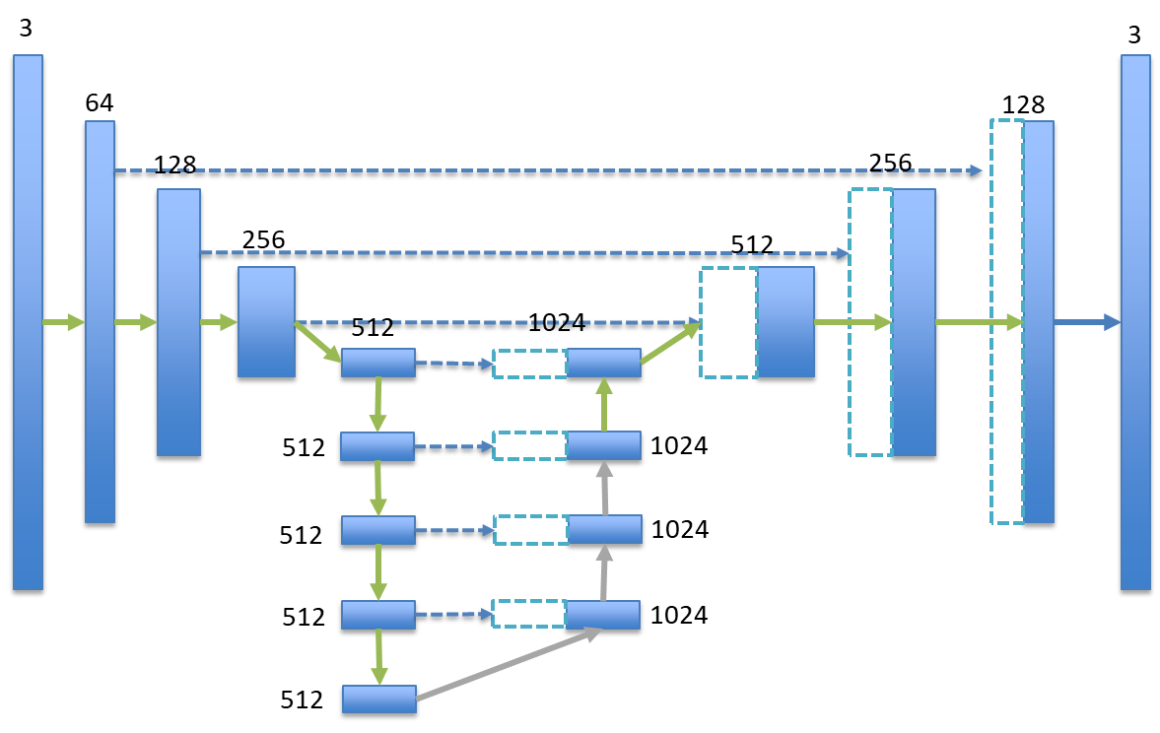
Data-driven preprocess
CNN + Skipping connections
Feature map
Concatenated feature map
Convolution – BatchNorm - ReLu
Convolution – BatchNorm – Dropout - ReLu
Concatenation (skipping connections)
Convolution - Sigmoid
12

Slide 19
Data-driven preprocess
CNN + Skipping connections
Mean Square Errors: MSE_{val_set} = 0.0003 ± 0.0002 Structural Similarity: SSIM_{val_set} = 0.97 ± 0.01
Training Time: 8 hours (NVidia GeForce RTX 3080)
Learning Rate: 0.0002 with exponential decay
Dropout Rate: 50%
Stochastic Gradient Descent
Adam Solver
Xavier weights initialization
13

Slide 20
Data-driven preprocess
CNN vs Pix2Pix
MODEL | MSE_{VAL} | SSIM_{VAL}
CNN | 0.0003 ± 0.0002 | 0.97 ± 0.01
Pix2Pix (Unet+PixelGAN) | 0.0004 ± 0.0002 | 0.96 ± 0.01
CNN
Pix2Pix
14

Slide 21
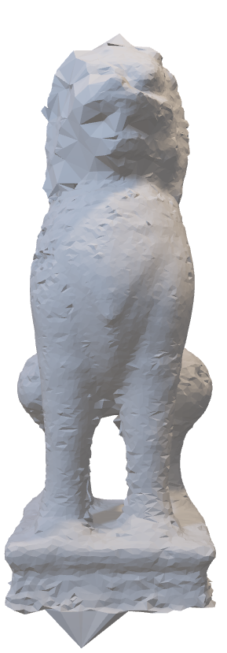
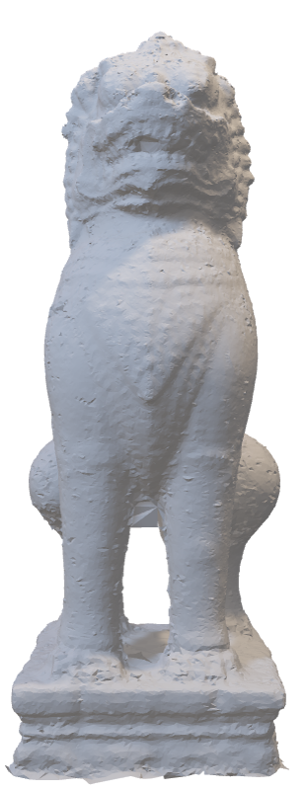
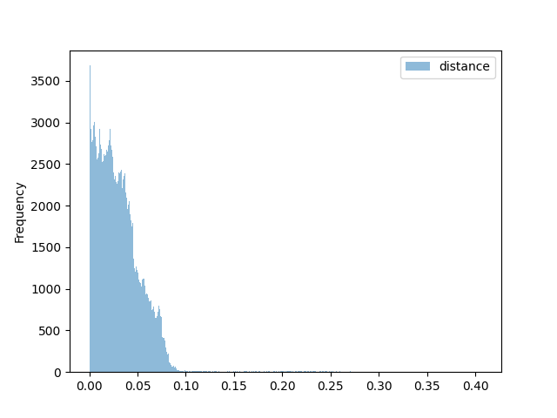
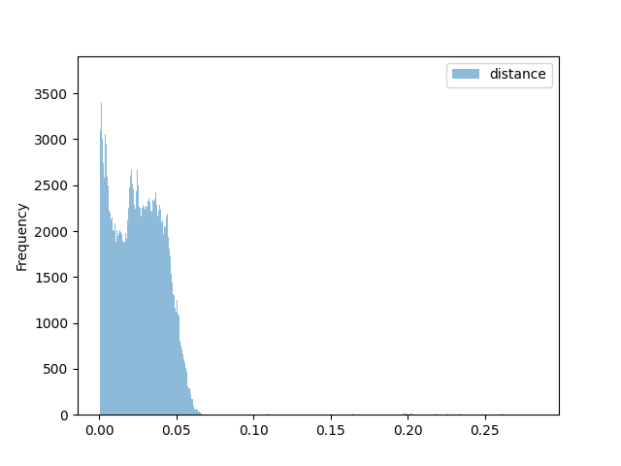
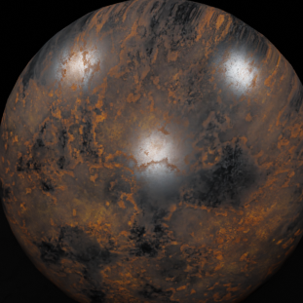
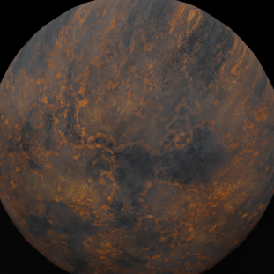
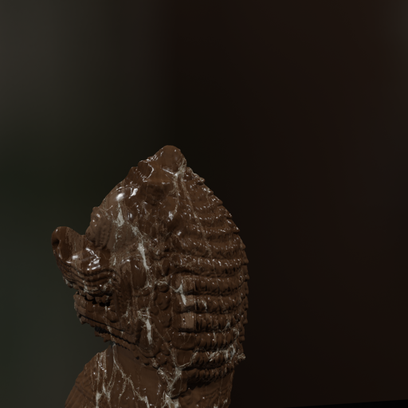
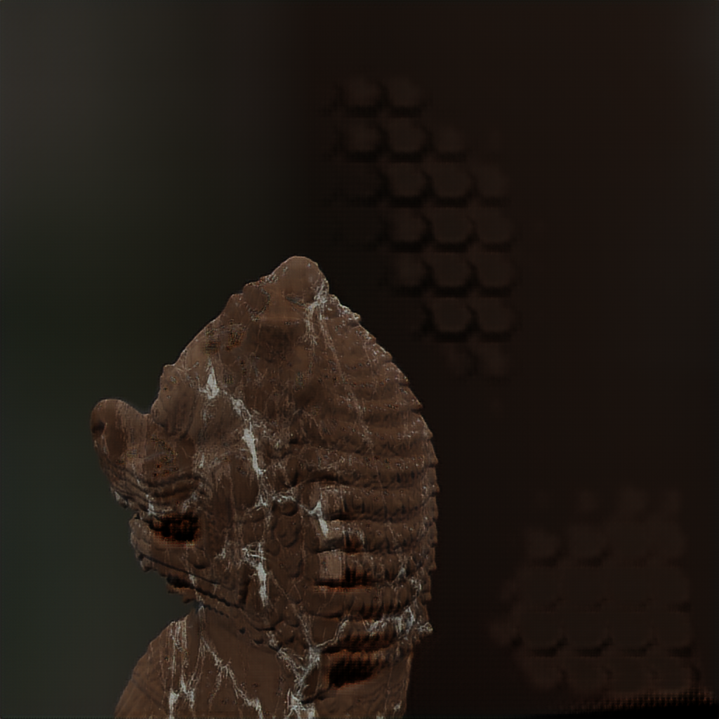
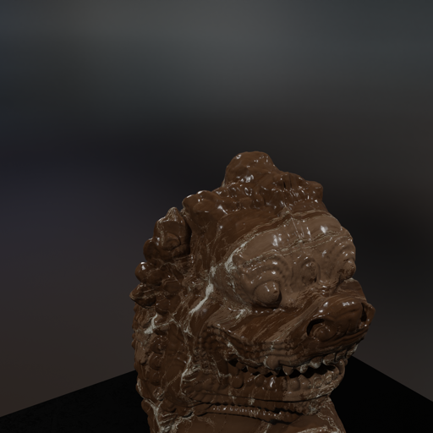
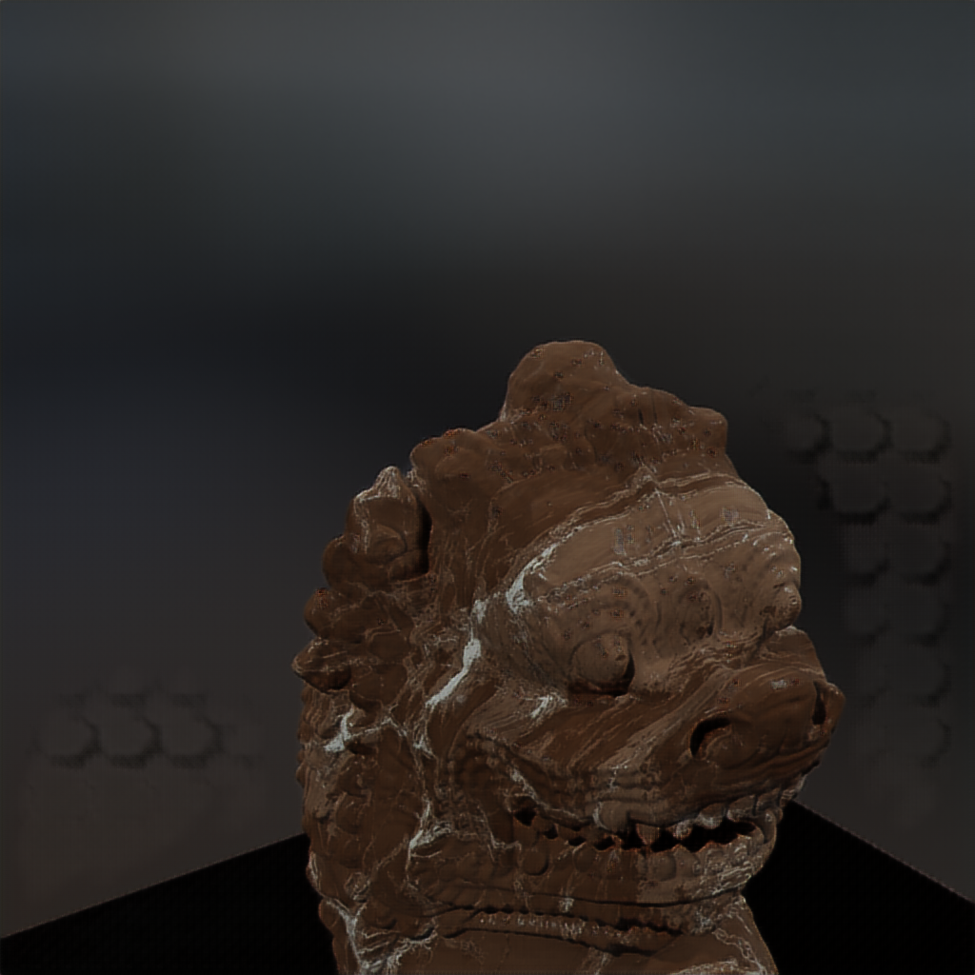
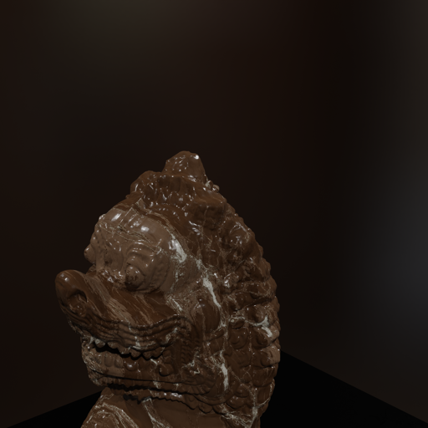
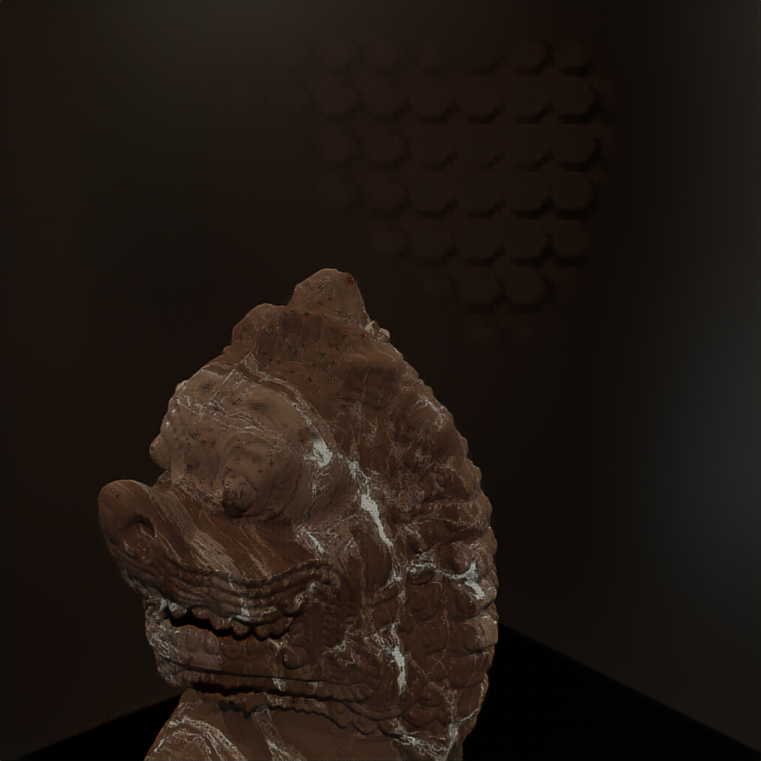
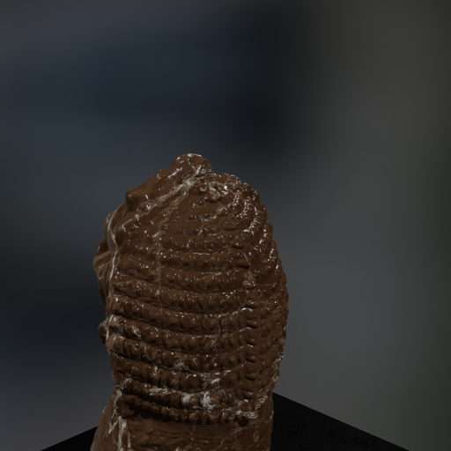
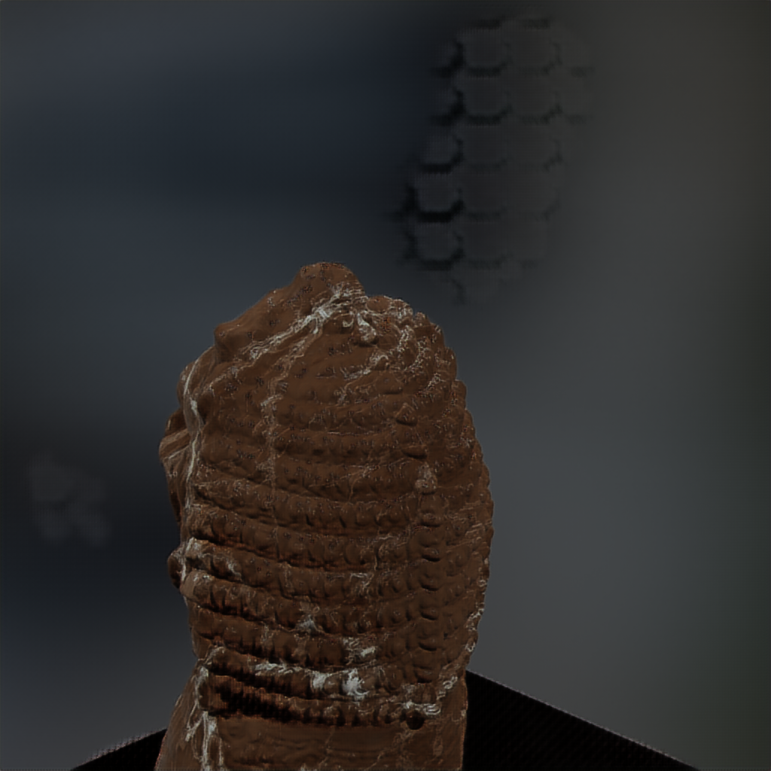
Data-driven preprocess
Results
Feature extraction
Image Matching
Structure from motion
Depth maps estimation
Meshing
Texturing
Photogrammetry
Quantitative
&
visual evaluation
Material transfer
Feature extraction
Image Matching
Structure from motion
Depth maps estimation
Meshing
Texturing
Photogrammetry
Original
Processed
 | Recon Points |  | Camera Used |  | HD |  | CD
 | Original | Processed | Original | Processed | Original | Processed | Original | Processed
Triton | 267387 | 310579 | 99% | 99% | 3.33E-03 | 3.16E-03 | 5.25E-05 | 5.16E-05
Bayon Lion | 295212 | 345797 | 95% | 98% | 6.65E-03 | 6.45E-03 | 3.45E-04 | 3.39E-04
Dragon | 193519 | 203778 | 73% | 82% | 8.46E-03 | 5.97E-03 | 2.86E-04 | 2.19E-04
John the Baptist | 462977 | 476058 | 100% | 100% | 2.19E-02 | 2.17E-02 | 2.23E-03 | 2.22E-03
HD: Hausdorff Distance, CD: Chamfer Distance
15

Slide 22
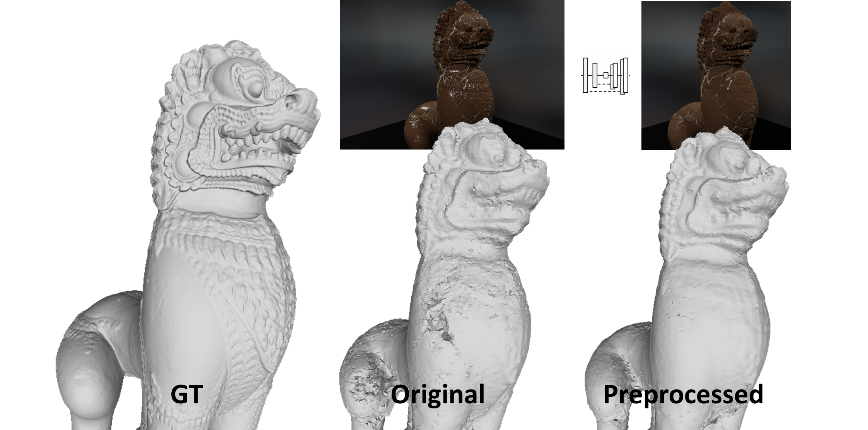
Data-driven preprocess
Results
16

Slide 23
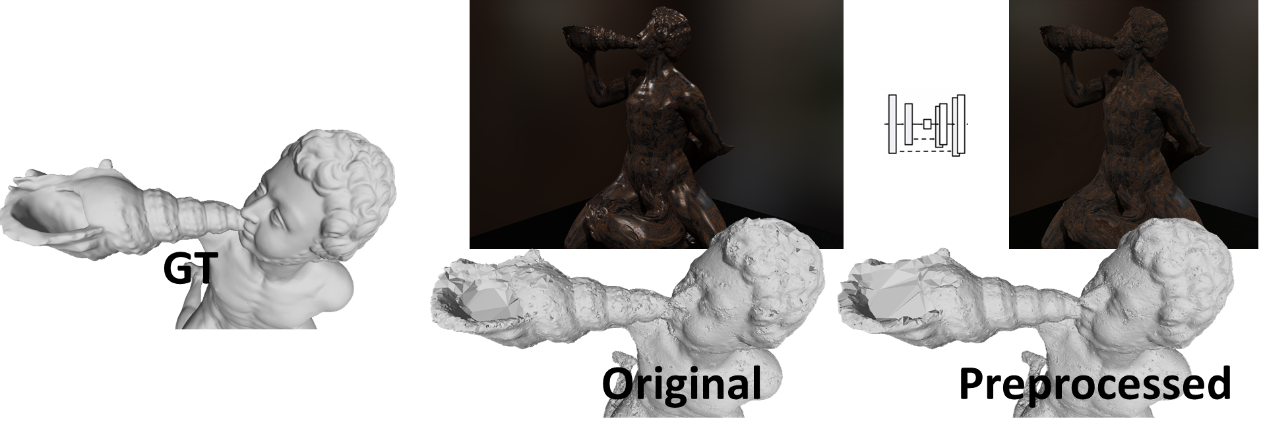
Data-driven preprocess
Results
17

Slide 24
Conclusion
We generated a synthetic dataset of photogrammetric acquisitions
  We developed an open-source software to customize photogrammetric setups.
We evaluated the assumption that reflective objects compromise photogrammetric reconstruction.
We proposed a deep learning model to transfer the material of the input images from reflective material to dull material.
  We showed that preprocessing with DL improved photogrammetry quantitatively and qualitatively
Limitation and future works
Completely synthetic dataset that might differs from the real scenarios.
  The next step in this work will be to test the proposed model on real-world cases. Real acquisitions may also increase the dataset itself.
18

Slide 25
Thank you for
your
attention!
https://github.com/HoenikkerPerez/DIP

